Slide 1

UNIT-1 Introduction to Object Oriented Programming
Dr. Arati V. Deshpande
arati.deshpande1@vit.edu
Department of Computer Engineering
BRACT’s, Vishwakarma Institute of Technology, Pune-37
(An Autonomous Institute affiliated to Savitribai Phule Pune University)
(NBA and NAAC accredited, ISO 9001:2015 certified)

Slide 2
Unit Objective and Outcome
Unit Objectives:
Differentiate various programming paradigms.
Unit Outcomes:
Understand object-oriented programming features.

Slide 3
Content
Programming Paradigms
Imperative and Declarative
Procedural programming paradigm and its limitations
Need of Object-Oriented Programming
Fundamentals of Object-Oriented Programming
Objects, Classes, Data Members, Methods, Data Encapsulation, Data Abstraction and Information Hiding, Inheritance, Polymorphism, Static and Dynamic Binding , Message Passing

Slide 4
Programming Paradigms
A programming paradigm is a method or approach that programmers use to write programs and solve problems.There are four main programming paradigms:
Imperative
Object-oriented
Functional
Logic (declarative)

Slide 5
Imperative Paradigm
Strongly associated with machine-level operations and the Von Neumann architecture.
It follows a sequential approach in which program execution proceeds through a series of step-by-step instructions.
The program state is modified using assignment statements, enabling the computation to progress until the intended outcome is achieved.
Example imperative languages:
Cobol, Fortran, C, Ada, Perl, …

Slide 6
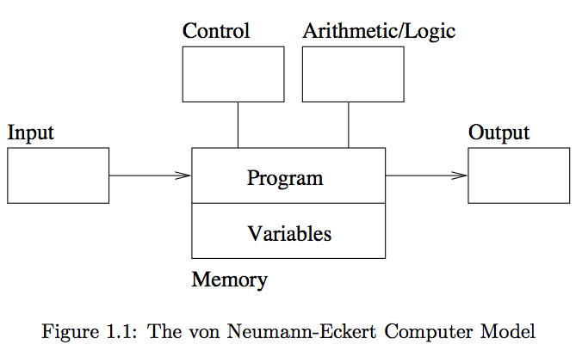
The von Neumann-Eckert Model

Slide 7
Object-oriented (OO) Paradigm
Object-oriented programming (OOP) is a programming paradigm that uses "objects".
A module in an OOP paradigm is made to be a collection of classes and objects rather than dividing an entire program into many subprograms or functions.
Data is hidden can not be easily accessed by external functions.
When studying OO, we learn about:
Sending Messages
Inheritance
Polymorphism
Example OO languages:
Smalltalk, Java, C++, C#, and Python

Slide 8
Functional Paradigm
Functional programming is a programming paradigm that treats computation as the evaluation of mathematical functions and avoids state changes and mutable data.
It emphasizes the application of functions, in contrast to the imperative programming style, which emphasizes changes in state.
Programs written using the functional programming paradigm are much more easily representable using mathematical concepts, and thus it is much more easy to mathematically reason about functional programs than it is to reason about programs written in any other paradigm.
Example functional languages:
Lisp, Scheme, ML, Haskell, …

Slide 9
Logic Paradigm
Logic programming declares what outcome the program should accomplish, rather than how it should be accomplished.
When studying logic programming we see:
Programs as sets of constraints on a problem
Programs that achieve all possible solutions
Programs that are nondeterministic
Example logic programming languages:
Prolog

Slide 10
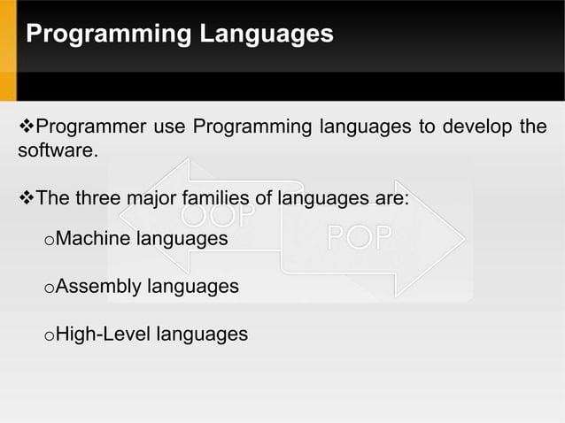

Slide 11
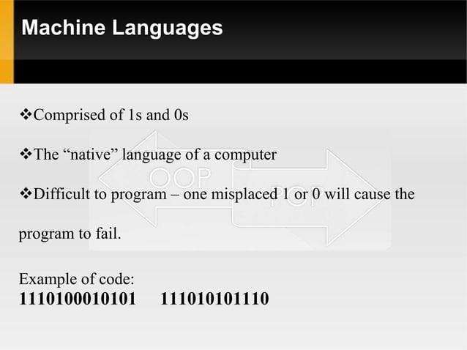

Slide 12
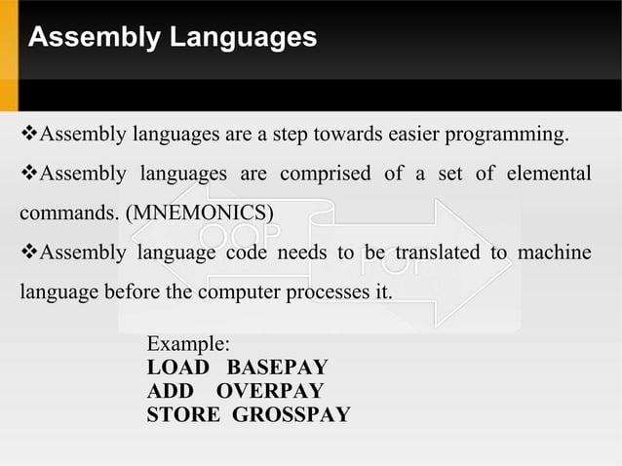

Slide 13
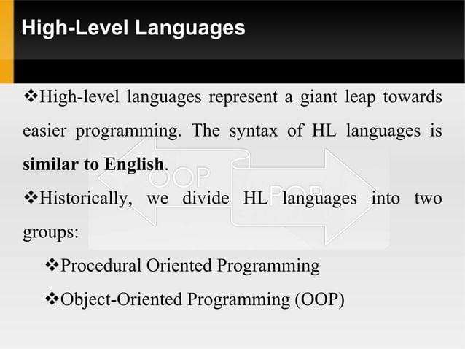

Slide 14
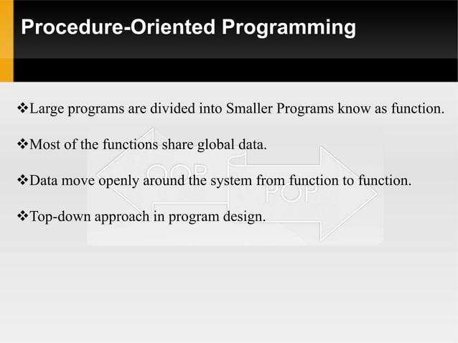

Slide 15
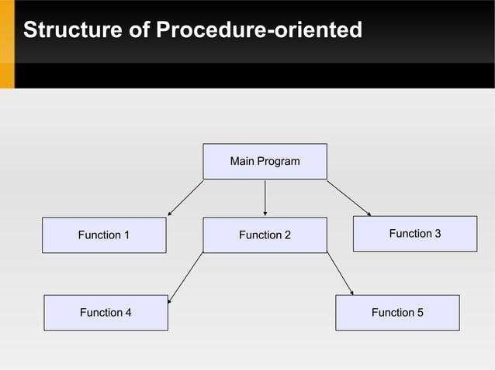

Slide 16
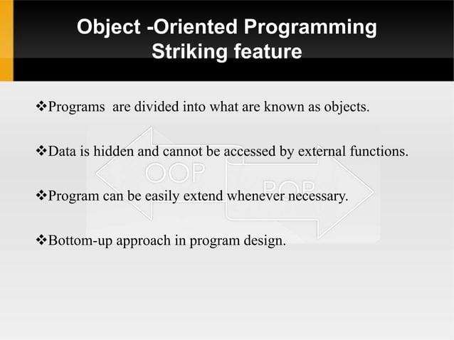

Slide 17
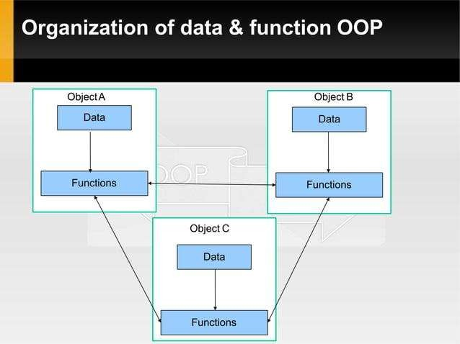

Slide 18
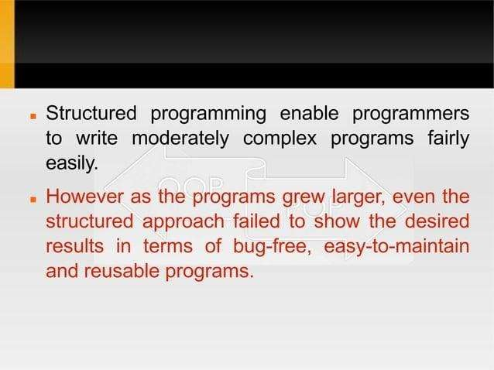

Slide 19
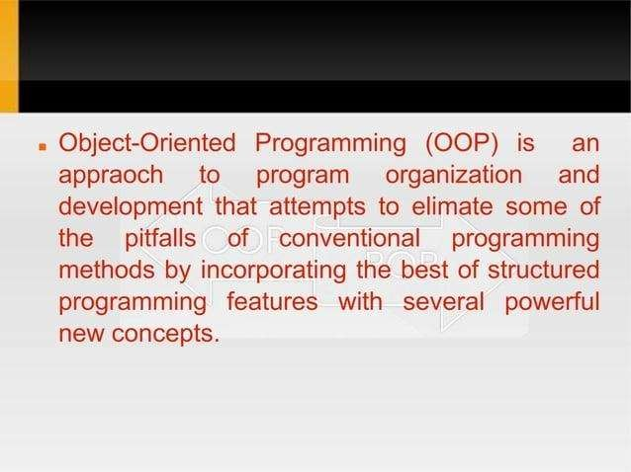

Slide 20
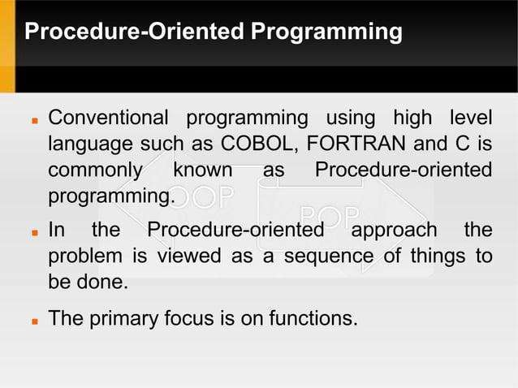

Slide 21
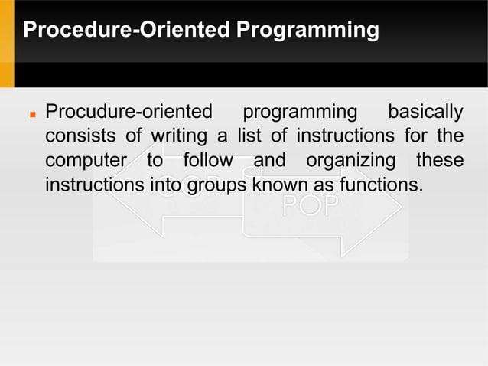

Slide 22
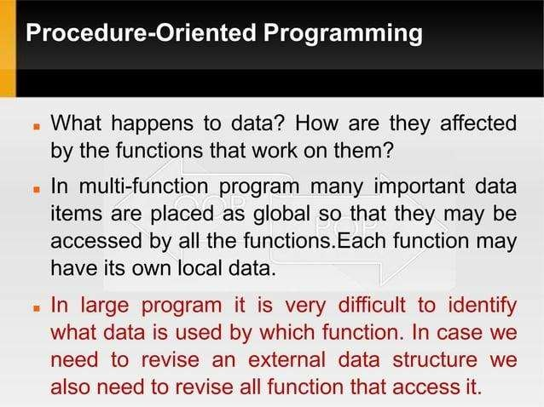

Slide 23
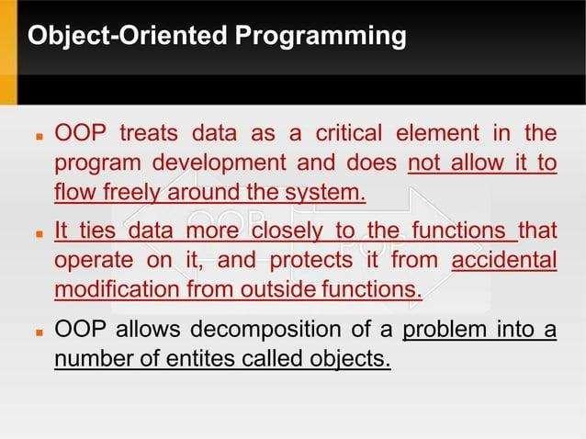

Slide 25
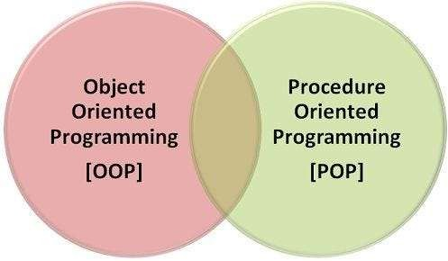

Slide 26
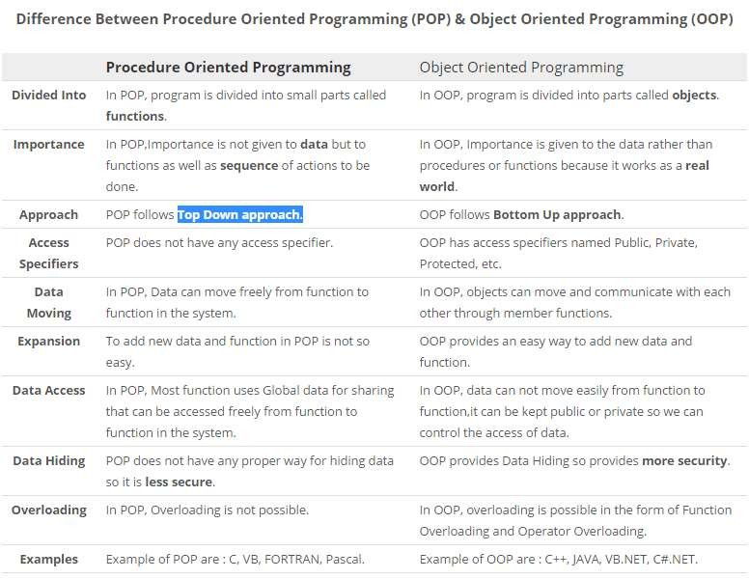
POP Vs OOP

Slide 27
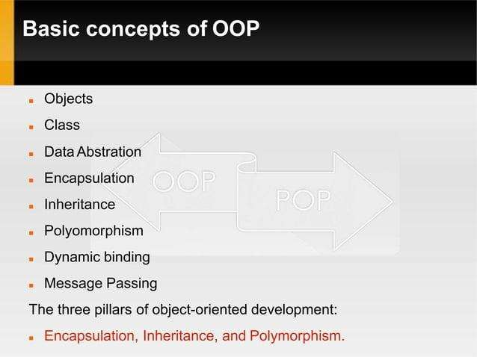

Slide 28
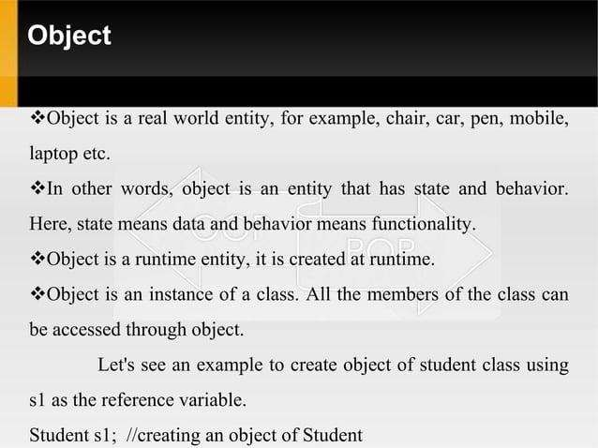

Slide 29
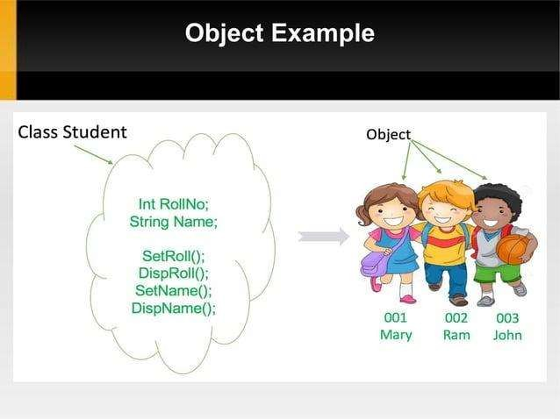

Slide 30
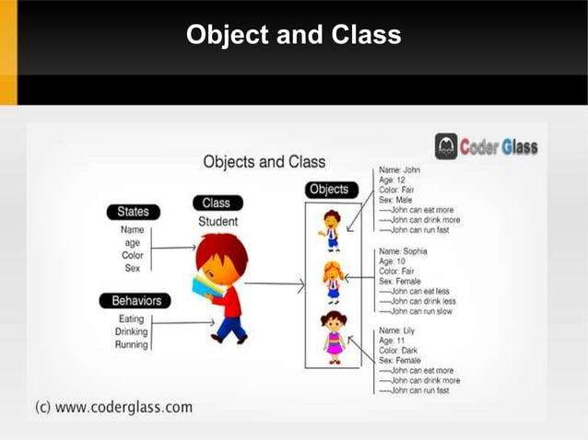

Slide 31
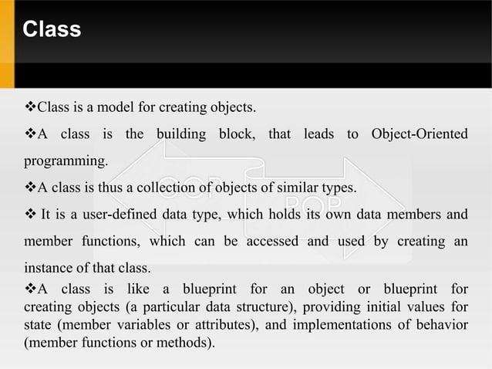

Slide 32
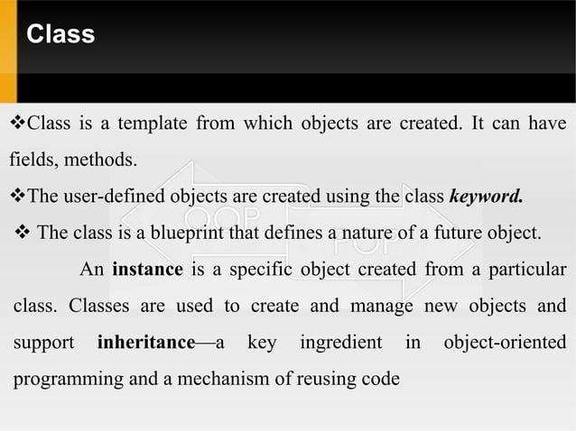

Slide 33
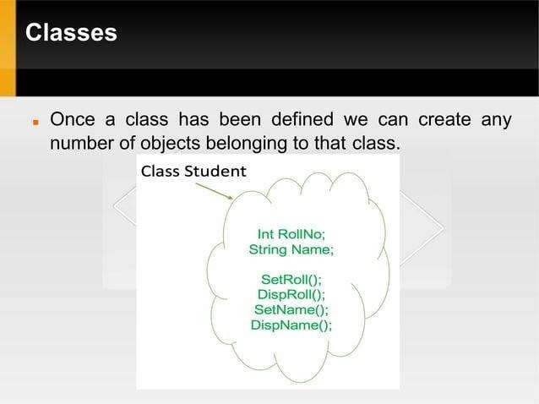

Slide 34
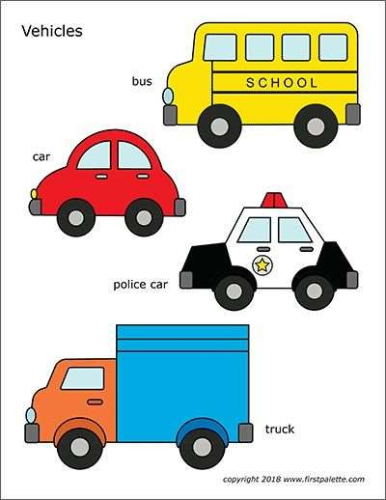

Slide 35
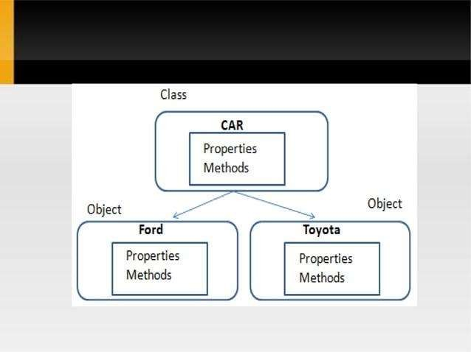

Slide 36
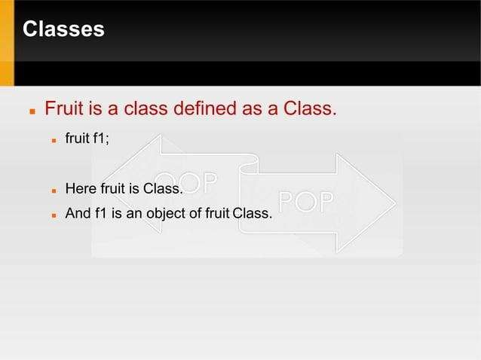

Slide 37
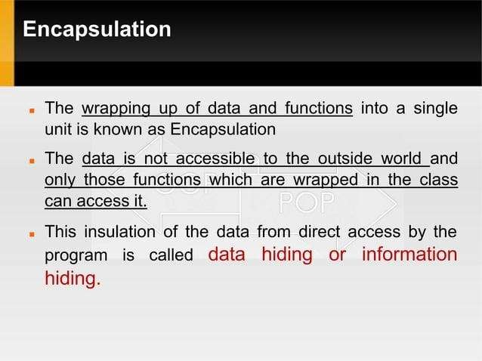

Slide 38
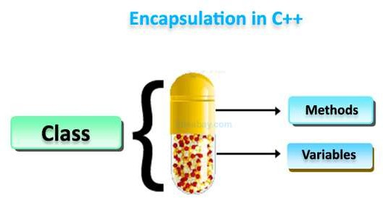

Slide 39
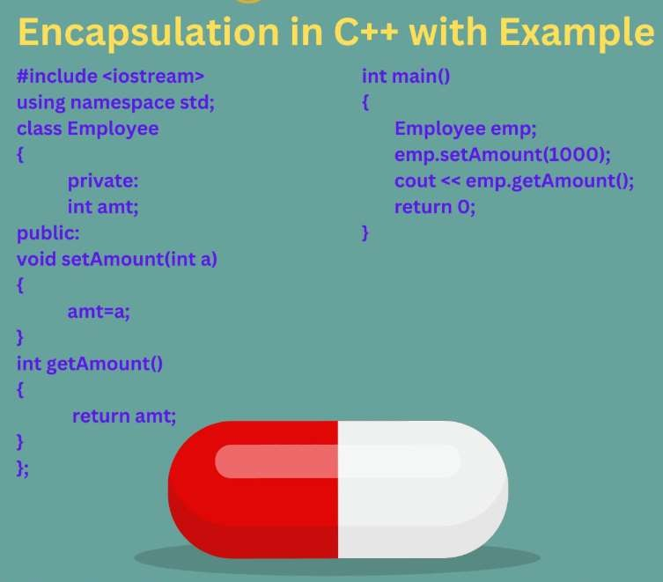

Slide 40
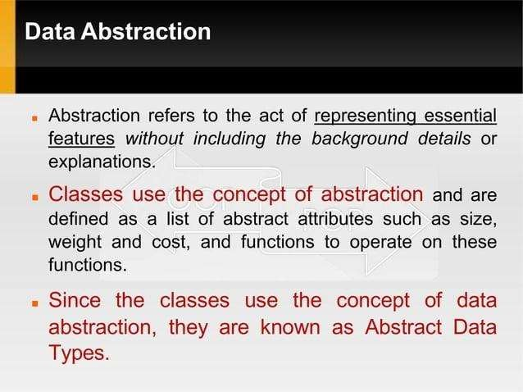

Slide 41
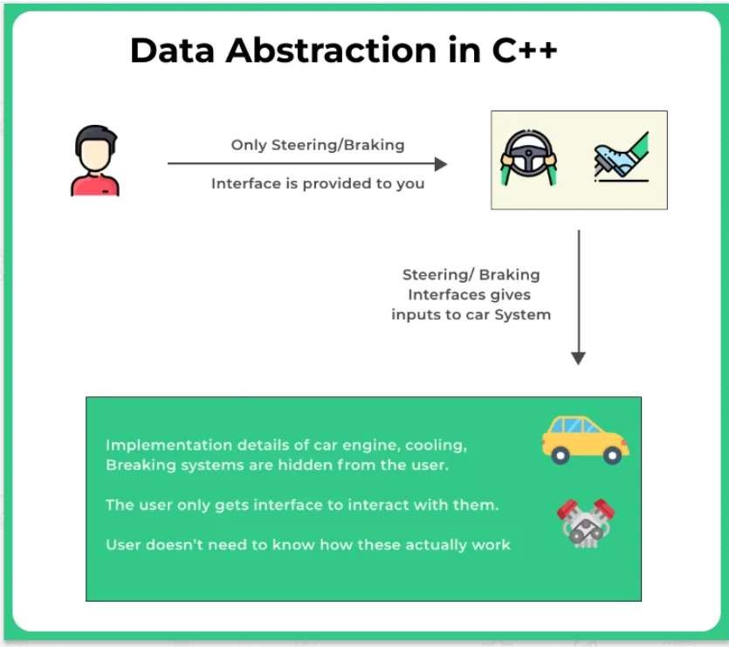

Slide 42
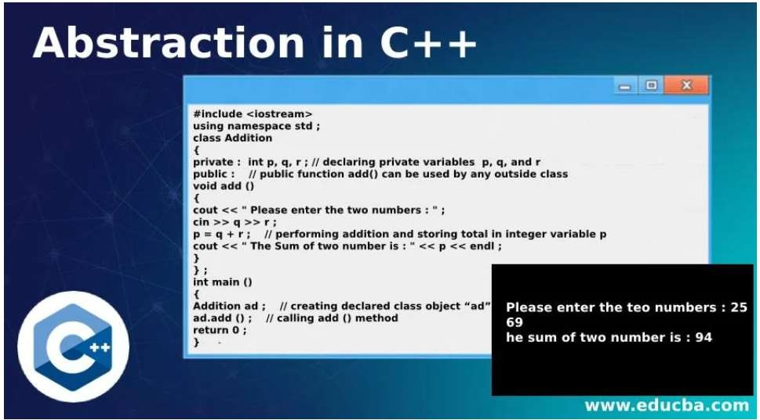

Slide 43
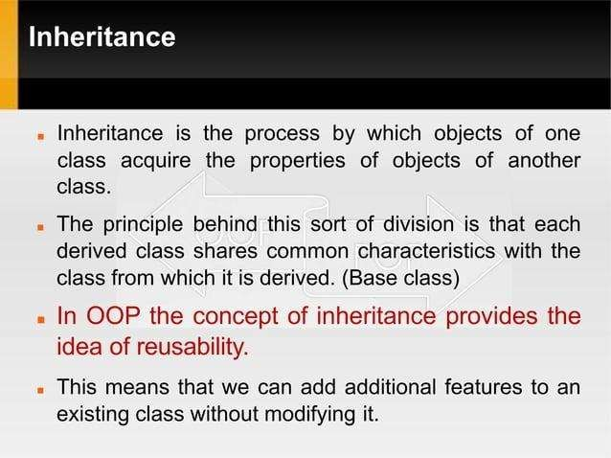

Slide 44
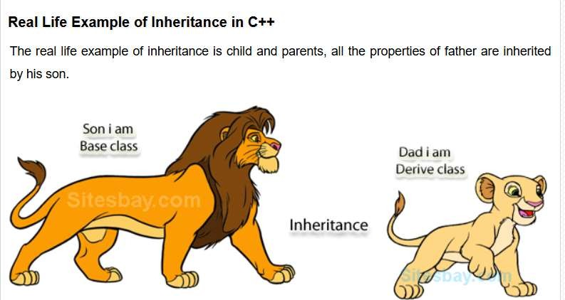

Slide 45
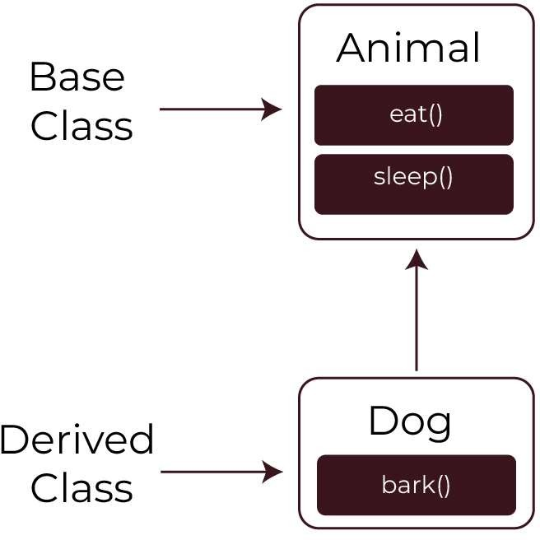

Slide 46
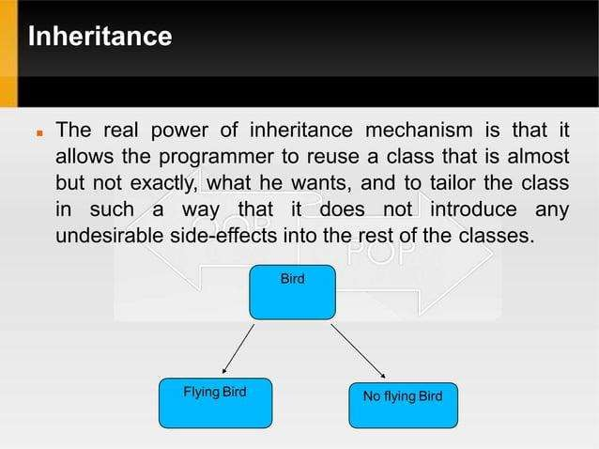

Slide 47
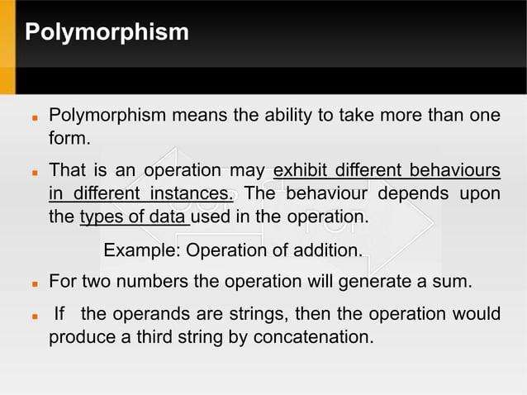

Slide 48
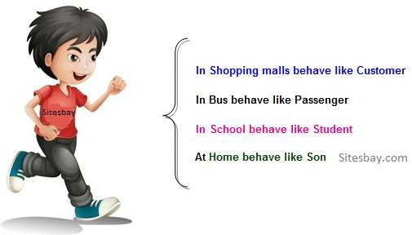

Slide 49
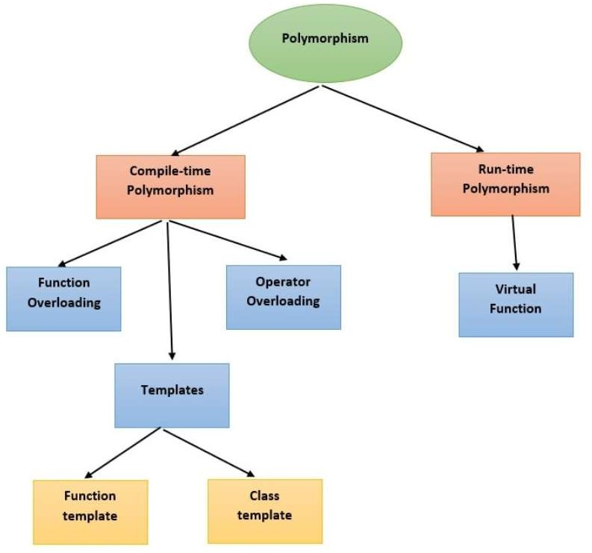

Slide 50
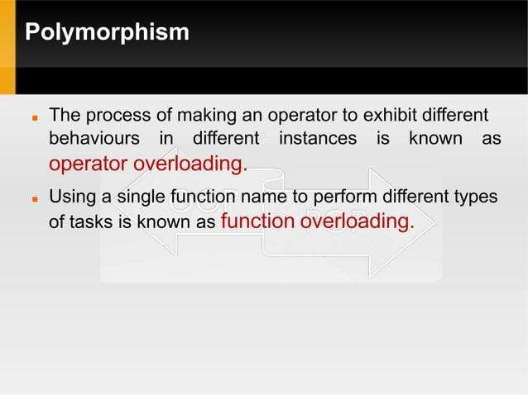

Slide 51
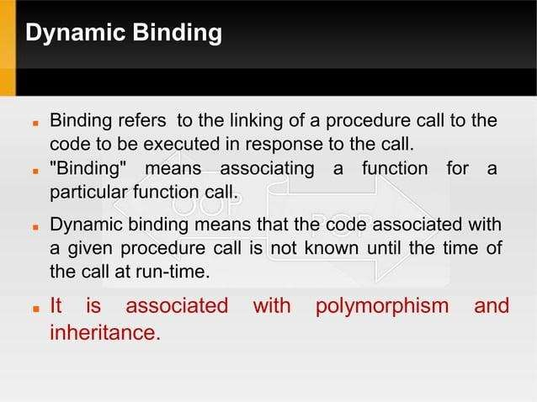

Slide 52
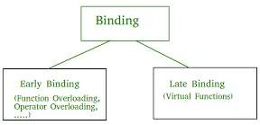

Slide 53
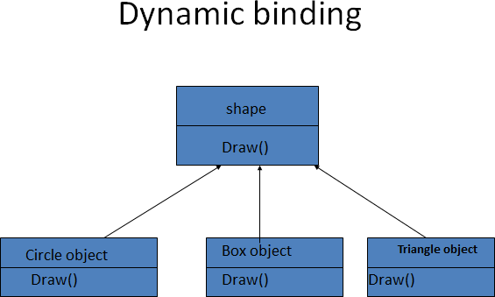

Slide 54
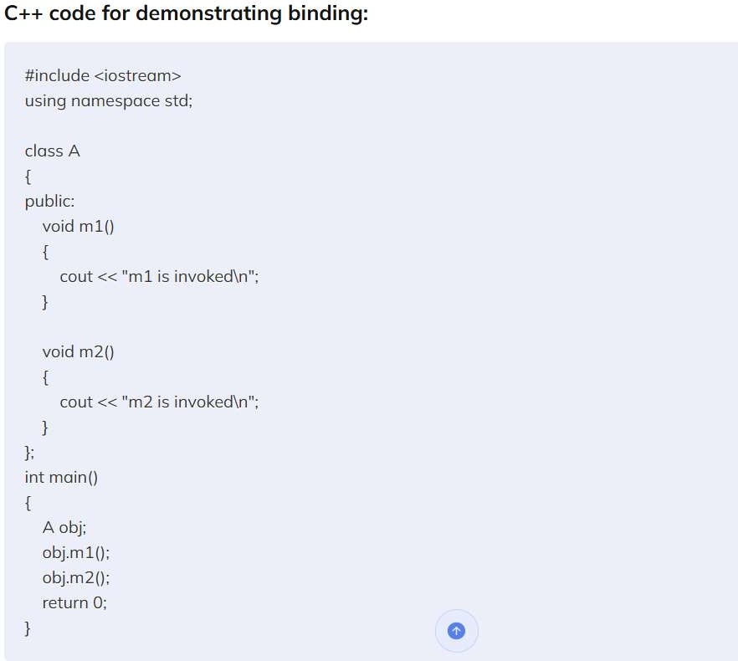

Slide 55
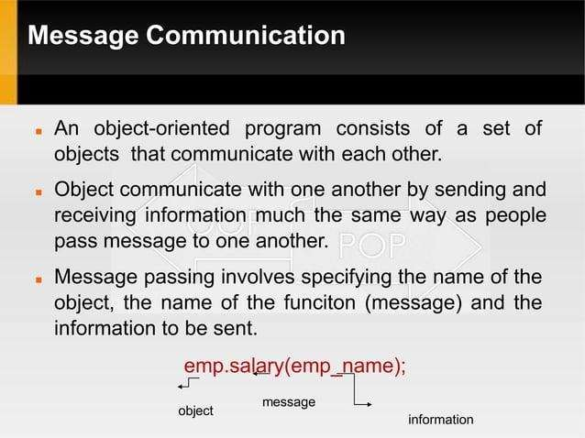

Slide 56
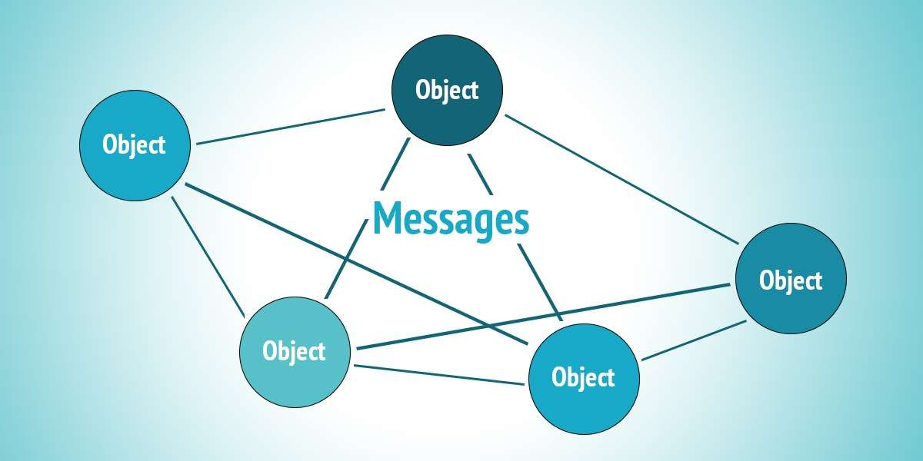

Slide 57
Data Hiding
Data hiding is a technique especially practiced in object-oriented programming (OOP).
Data hiding is hiding the details of internal data members of an object.
Data hiding is also known as Information hiding.
Sometimes Data Hiding includes Encapsulation. Thus Data Hiding is heavily related to Abstraction and Encapsulation.
Data Hiding is the one most important OOP mechanism. Which is hide the details of the class from outside of the class.
The Class used by only a limited set of variables and functions, others are hidden by the class.

Slide 58
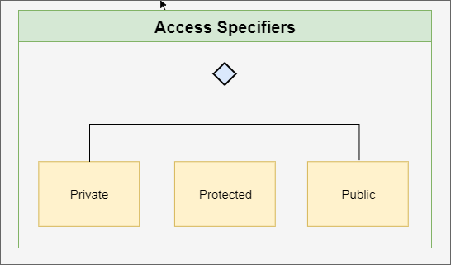

Slide 59
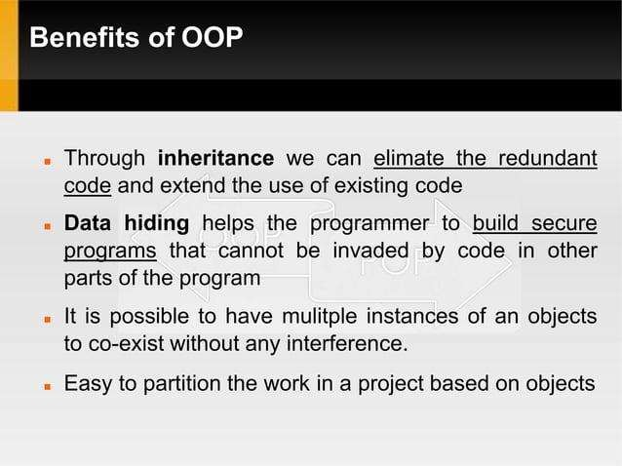

Slide 60
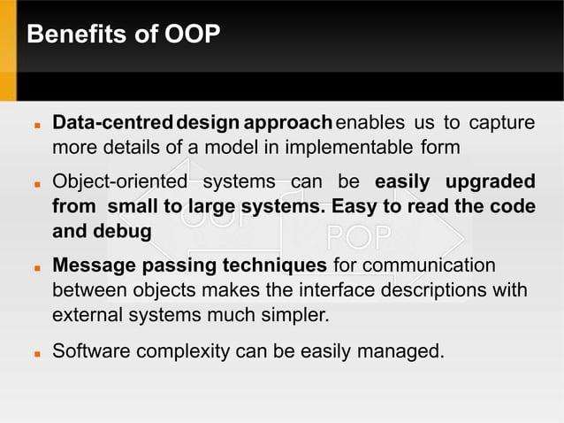

Slide 61
References
[1] E. Balaguruswamy, “Object Oriented Programming Using C++ ”, Tata McGraw Hill.
[2] Cpp programming : An Introduction : Tech books Press , November 2010

Slide 62


THANK YOU
Vishwakarma Institute of Technology, Pune

